Slide 1
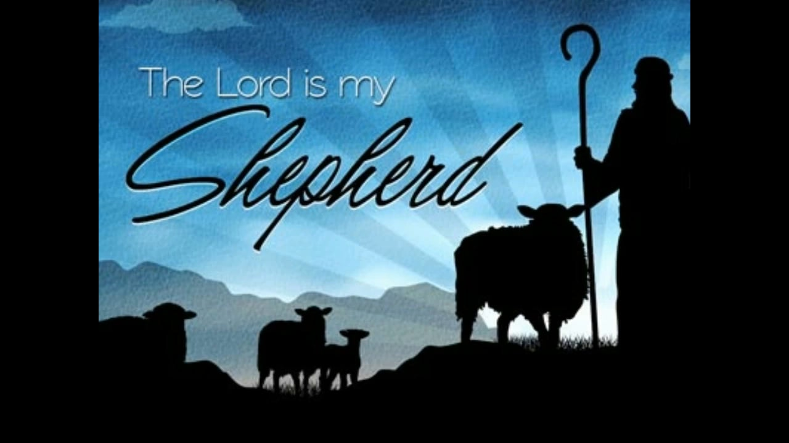
The 23rd Psalm
(Part 2)

Slide 2
Psalms 23
1 The LORD is my shepherd – FAITH
I shall not want – ASSURANCE
2 He maketh me to lie down in green pastures – CONTENTMENT
He leadeth me beside the still waters – PEACE

Slide 3
Psalms 23
3 He restoreth my soul – LIFE
He leadeth me in the paths of righteousness for his name's sake – LEADERSHIP
4 Yea, though I walk through the valley of the shadow of death – CONFIDENCE
I will fear no evil – COURAGE.
For thou art with me – COMPANIONSHIP
Thy rod and thy staff they comfort me – COMFORT

Slide 4
Psalms 23
5 Thou preparest a table before me in the presence of mine enemies – PROVIDENCE
Thou anointest my head with oil – FAVOR
My cup runneth over – JOY
6 Surely goodness and mercy shall follow me all the days of my life – MERCY
And I will dwell in the house of the LORD for ever – IMMORTALITY

Slide 5
Life: “He restoreth my soul”
To restore the soul seems to imply life again.
cf. James 2:26
“If a man die, shall he live again.” Job 14:14
  This is why David was not afraid to walk through the valley of the shadow of death.
  This is why he ate instead of fasting when his son died.
  He could go to him. 2 Samuel 12:22-23
Evidently David foresaw the resurrection.
cf. Psalms 16:10; Acts 2:31
Jesus spoke of the resurrection. John 11:25
  All will be raised. John 5:28-29

Slide 6
Leadership: “He leadeth me in the paths of righteousness for His name’s sake”
The Lord leads, David followed.
  Man cannot direct his own steps. cf. Jeremiah 10:23
David was led by God through the teaching of the OT
Today God leads us through the NT
  God’s righteousness is found in the gospel.
  Romans 1:16-17
  All of us are to walk by this same rule.
  Philippians 3:15-16

Slide 7
Leadership: “He leadeth me in the paths of righteousness for His name’s sake”
The Lord leads and we are to follow. Lk. 9:23
Many rather elect to follow blind guides.
cf. Matthew 15:14
  Their end is the ditch. cf. verse 13
The Lord is the Good Shepherd and cares for the sheep. John 10:1-4,11-14
  We can follow with confidence.

Slide 8
Leadership: “He leadeth me in the paths of righteousness for His name’s sake”
The Lord has the words of life.
Peter and the disciples could not look elsewhere.
cf. John 6:66-68; cf. John 16:13f; Romans 8:14
Now He has proven that He can and will lead us through the valley of the shadow of death.
  He was tempted. cf. Matthew 4:1-11; Hebrews 4:15
  He died. Hebrews 2:14-15; cf. Revelation 1:17-18
  And He proved that man can and will be raised from the dead. cf. Acts 2:24; Colossians 2:15
We are to walk as He walked. 1 John 2:5-6;
1 Peter 2:21

Slide 9
Confidence: “Yea, though I walk through the valley of the shadow of death”
The walk is the walk all men must take.
Hebrews 9:27; Ecclesiastes 9:5
Such confidence is born of hope.
Philippians 1:23; 2 Corinthians 5:6,8
Such hope should rest upon the promises of God. 2 Peter 1:4; Hebrews 10:22-23
All the fear of death should be removed from us. Hebrews 2:14-15; Hebrews 13:5-6

